Slide 1
Floyd-Warshall Algorithm

Slide 2
Introduction
So far we have seen:
BFS/ DFS
Dijkstra
Bellman-Ford Algorithm
All of these algorithms are Single Source Shortest Path (SSSP) Algorithm.

Slide 3
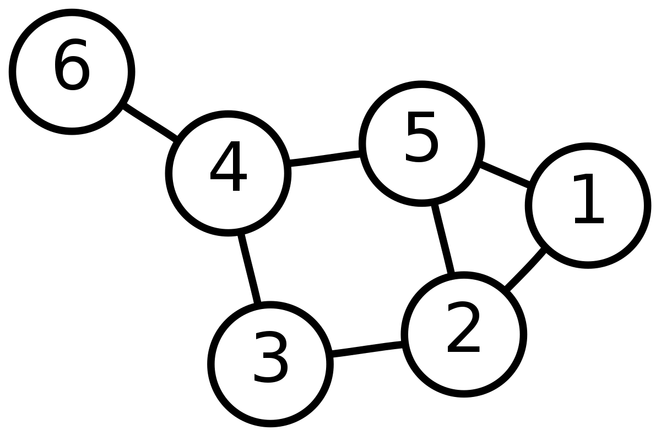
Introduction
What if we want to find the shortest distance between all pair of nodes?
d[1][2] = 1 d[2][3] = 1
d[1][3] = 2 d[2][4] = 2
d[1][6] = 3 .
. .
. .
.
.

Slide 4
Introduction
Can we use Dijkstra / Bellman – Ford algorithm?
Yes we can.
Run Dijkstra algorithm |V| times.
each time taking a different starting node.
What will be the complexity?
O (E log V) * V
For dense graph it will be O(V³logV)
Can we do better?

Slide 5
Floyd-Warshall Algorithm
Find the shortest paths between all pairs of vertices in a weighted graph.
Dynamic programming algorithm.

Slide 6
Working Procedure
Initialization
For SSSP algorithms we used a distance array d[].
Now we need a distance matrix d[][].
Fill the matrix:
If i==j, d[i][j] = 0
If there is an edge, d[i][j] = weight of the edge
Otherwise, d[i][j] = INFINITY

Slide 7
Working Procedure
Main Algorithm
For each vertex ‘k’ ( intermediate node) consider all pair of vertex i,j.
Update d[i][j] if
d[i][j]>d[i][k]+d[k][j]

Slide 8
Complexity
O(V³)

Slide 9
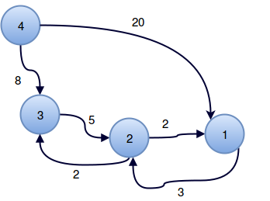
Example
Node | 1 | 2 | 3 | 4
1 | 0 | 3 | ∞ | ∞
2 | 2 | 0 | 2 | ∞
3 | ∞ | 5 | 0 | ∞
4 | 20 | ∞ | 8 | 0

Slide 10
Example
Consider k = 1
Node | 1 | 2 | 3 | 4
1 | 0 | 3 | ∞ | ∞
2 | 2 | 0 | 2 | ∞
3 | ∞ | 5 | 0 | ∞
4 | 20 | 23 | 8 | 0

Slide 11
Example
Consider k = 2
Node | 1 | 2 | 3 | 4
1 | 0 | 3 | 5 | ∞
2 | 2 | 0 | 2 | ∞
3 | 7 | 5 | 0 | ∞
4 | 20 | 23 | 8 | 0

Slide 12
Example
Consider k = 3
Node | 1 | 2 | 3 | 4
1 | 0 | 3 | 5 | ∞
2 | 2 | 0 | 2 | ∞
3 | 7 | 5 | 0 | ∞
4 | 15 | 13 | 8 | 0

Slide 13
Example
Consider k = 4
Node | 1 | 2 | 3 | 4
1 | 0 | 3 | 5 | ∞
2 | 2 | 0 | 2 | ∞
3 | 7 | 5 | 0 | ∞
4 | 15 | 13 | 8 | 0

